Slide 1
Levenshtein + OCR
How to use data and a "just okay" OCR to get a great experience
Peter Kingston: Site Coordinator, MCP
Kerr Concentrates
https://www.github.com/peterjkingston/LevenshteinOCR

Slide 2
Plain Document (Image, PDF, etc)
OCR
Document with searchable text
Information that identifies the document
OCR
DB
Document #: 5561284
Customer Name: ABC Co.
OCR
Engine
Doc Type: Promissory Note
Save this off as a temporary file, you’ll probably want to do something with it later…

Slide 3
Document with searchable text
Wash these
Actual vs Recognized
Promissory Note
Prom1ssory 1Vota
Prom1ssory Nota
5561284
SSbl2BA
5561284
ABC Co.
ABC Co
ABC Co

Slide 4
?
Promissory Note
Prom1ssory Nota
5561284
5561284
ABC Co.
ABC Co

Slide 5
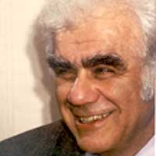
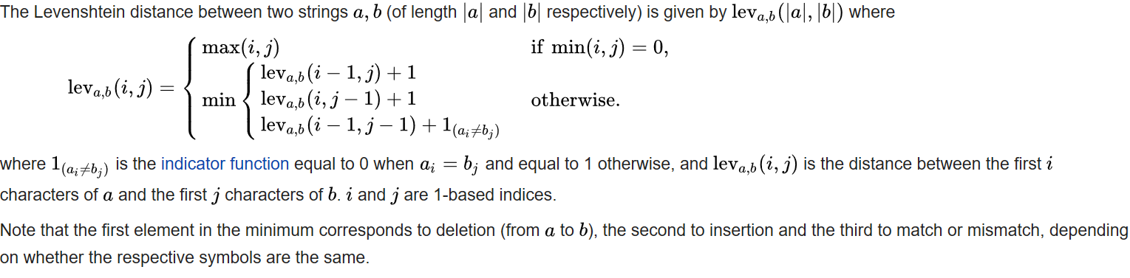
VLADIMIR LEVENSHTEIN’S EDIT DISTANCE BETWEEN TWO STRINGS

Slide 6
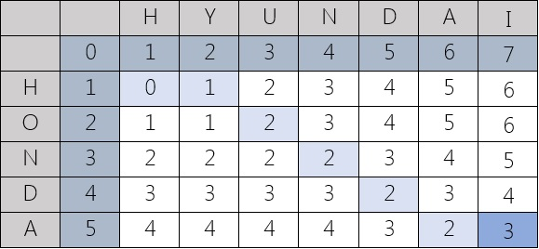
VLADIMIR LEVENSHTEIN’S EDIT DISTANCE BETWEEN TWO STRINGS
Example:

Slide 7
GET EDIT DISTANCE AS A CODE EXAMPLE
public static int GetEditDistance(string s1, string s2)
{
int l1 = s1.Length;
int l2 = s2.Length;
int[,] d = new int[l1+1,l2+1];
//Initiate the matrix
for(int i = 0; i <= l1; i++) {d[i, 0] = i;}
for(int j = 0; j <= l2; j++) {d[0, j] = j;}
//Adjust for strings
for(int i = 1; i <= l1; i++)
{
for(int j = 1; j <= l2 ; j++)
{
if(s1[i-1] == s2[j-1])
{
d[i,j] = d[i-1,j-1];
}
else
{
int min1 = d[i - 1, j] + 1;
int min2 = d[i, j - 1] + 1;
min1 = min2 < min1? min2: min1;
min2 = d[i - 1, j - 1] + 1;
min1 = min2 < min1? min2: min1;
d[i,j] = min1;
}
}
}
//Return the end of the matrix
return d[l1,l2];
}

Slide 8
CREATE A WRAPPER METHOD TO GET DIFFERENCE IN STRINGS BY PERCENT
public bool IsCloseTo(string thisStr, string thatStr, double thresholdpercent)
{
int largestLength = GetLargestLength(thisStr, closeTo);
int editDistance = GetEditDistance(thisStr, closeTo);
double percent = ((largestLength - editDistance) / largestLength);
return percent >= thresholdpercent;
}

Slide 9
COMPARE YOUR EXPECTED STRING TO YOUR ACTUAL STRING
IsCloseTo( , , 0.5 )
Promissory Note
Prom1ssory Nota
Is “Promissory Note” close to “Promlssory Nota” by at least half?
Yes it is!
Awesome, this text actually says “Promissory Note”

Slide 10
VALIDATE YOUR DATA
Some variable information that doesn’t change
Try a different data point or OCR scan
OCR Customer Name
Your cleanest reference
OCR Doc #
False
Compare by IsCloseTo
Validation Result
MATCH RECORD
True
Docs
DB
DB Doc #
DB Customer Name
This document corresponds to this record

Slide 11
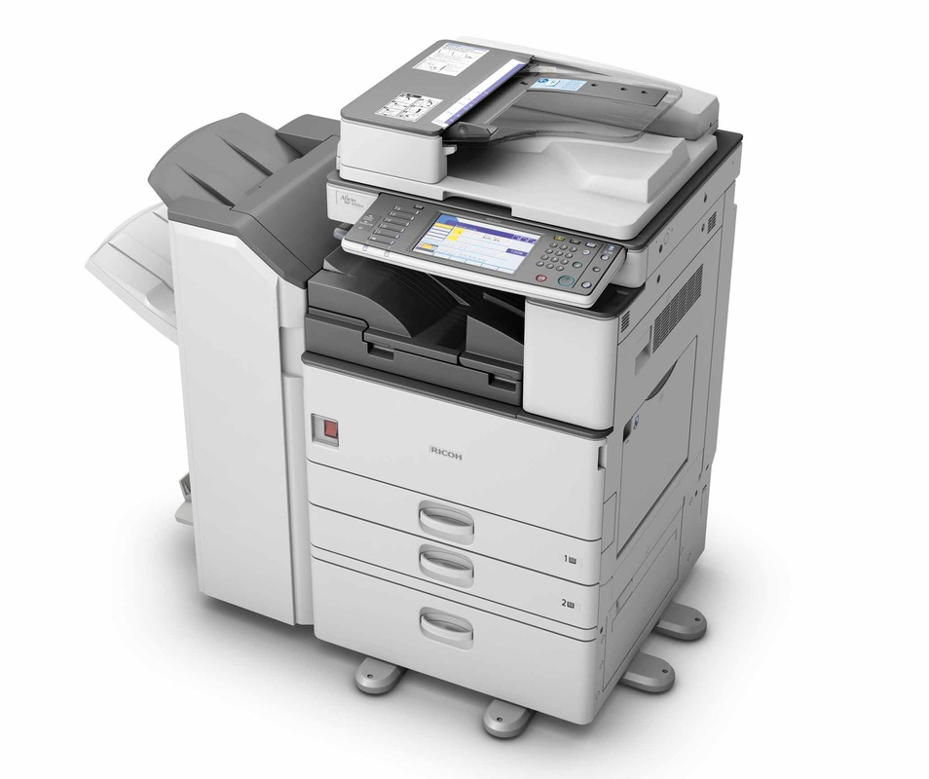

My Application
The copier I use has an OCR option
After scanning, OCR is performed on the PDF before being sent to my Inbox

Slide 12


My Application
NewMailEx
MailItemIDs in
Comma Delimited Text
Once my local instance of Outlook receives the mail containing the scans, I parse through the objects until I get my OCR’d PDF

Slide 13
My Application
For each page, I search for the Doc Type by comparing expected headers that are common for that type of document to the OCR text on the form. Adobe can locate text by coordinate points.
Doc Type
Order Reference #
Once the Doc Type is found, I then know where to look for the other information.
I dig up and clean the Order Reference #, and the Customer Name
Customer Name
Because some documents can be scanned in with some variance in regards to the edges of the page, I’ve implemented a function to search against expected data at the target area, then nearby until something looks close enough.

Slide 14
My Application
As each page is identified, and processed, the application fires events that trigger a variety of other services:
Creating folder labels
Separating and virtually filing different forms inside the scan
Edit the originating mail item for easy reference in the future
Generate emails and attach regularly requested forms
+

